Slide 1

Deep Neural Network (DNN)
Module 1: Introduction to Deep Learning

Slide 2
Part 1: What is Deep Learning?
Defining the field and its core concepts

Slide 3
What is Deep Learning? (Definition 1)
A Subset of Machine Learning
Deep Learning is a type of machine learning.
It is based on artificial neural networks (ANNs).
It uses multiple layers of processing to learn from data.
These layers form a "deep" network, which gives the field its name.

Slide 4
What is Deep Learning? (Definition 2)
Inspired by the Human Brain
It is a method in AI that teaches computers to process data in a way that is inspired by the human brain.
It's a machine learning technique that teaches computers to do what comes naturally to humans: learn by example.
This contrasts with older AI systems that relied on hand-crafted rules.

Slide 5
What is Deep Learning? (Definition 3)
Hierarchical Representation Learning
Deep Learning is about learning successive layers of increasingly meaningful representations.
Multiple layers are used to extract progressively higher-level features from data.
For an image, the first layer might learn edges, the next shapes, and the next complex objects.

Slide 6
What is "Depth"?
The "Deep" in Deep Learning
The "deep" in deep learning stands for this idea of successive layers of representations.
The depth of a model is the number of layers that contribute to modeling the data.
A neural network with three or more layers is generally considered a "deep" neural network.

Slide 7
Part 2: Where Deep Learning Fits
Understanding the AI Landscape

Slide 8

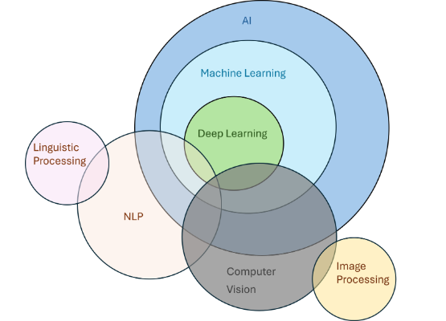
The AI-ML-DL Hierarchy
AI → ML → DL
Artificial Intelligence (AI): The broad science of making machines smart or mimicking human intelligence.
Machine Learning (ML): A subset of AI where systems *learn from data* to find patterns and make predictions.
Deep Learning (DL): A subset of ML that uses "deep" neural networks to solve complex problems.

Slide 9


AI vs. ML vs. DL: Key Distinctions
AI (Artificial Intelligence)
ML (Machine Learning)
Any technique that enables computers to mimic human intelligence. This includes rule-based systems, logic, and more.
A subset of AI where machines *learn from data* to perform tasks without being explicitly programmed for each case.

Slide 10
Part 3: How Deep Learning Works
The Core Idea of Layered Representations

Slide 11
Learning Successive Layers
Layers of Meaningful Representations
DL models are learned via models called neural networks, structured in literal layers stacked on top of each other.
Each layer takes the output from the previous one and transforms it into a new representation.
The goal is for the final representation to make the task (like classification) easy.

Slide 12
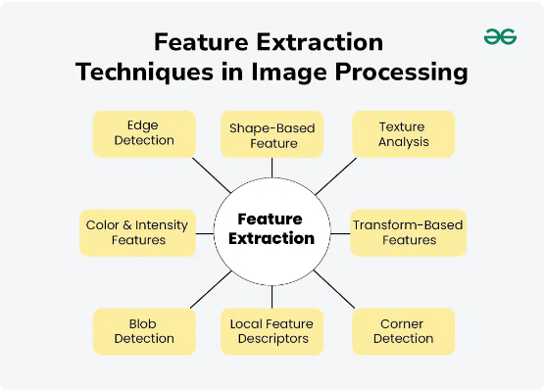
Visualizing the Layers
From Pixels to Concepts
Layer 1 (Input): Detects simple features (e.g., edges, colors).
Layer 2 (Hidden): Combines features into simple shapes (e.g., corners, circles).
Layer 3 (Hidden): Combines shapes into complex parts (e.g., an eye, a nose).
Layer 4 (Output): Assembles parts into the final concept (e.g., a "cat").

Slide 13
Part 4: Why Deep Learning? Why Now?
The Confluence of Four Key Factors

Slide 14




Factors 1 & 2: Data and Storage
1. Data Availability
2. Cheap Storage
We now have massive datasets (e.g., ImageNet, Wikipedia) needed to train deep networks.
The cost of storing terabytes of data has plummeted, making these large datasets feasible to collect and maintain.

Slide 15




Factors 3 & 4: Computation & Algorithms
3. Computational Power
4. Algorithms
The rise of GPUs (Graphics Processing Units) allows for massive parallel computations, making training feasible.
Key algorithmic innovations (like new activation functions, optimizers, and backpropagation) made training deep nets practical.

Slide 16
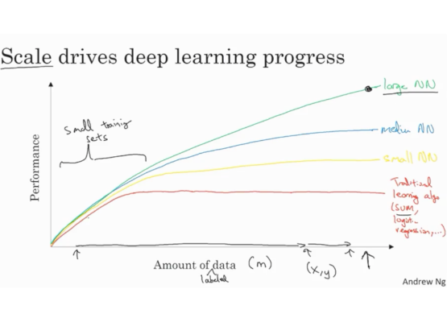
The Scalability of Deep Learning
Performance vs. Data
Traditional ML algorithms (like SVMs or Logistic Regression) plateau in performance.
After a point, more data doesn't help them.
Deep Learning models scale. Their performance keeps improving with more data.
This is the key advantage of DL: it can harness massive datasets.

Slide 17
Part 5: A Brief History
From Perceptrons to Transformers

Slide 18
Deep Learning Timeline (Simplified)
1957
2012
Perceptron (Frank Rosenblatt. An early single-layer neural network)
AlexNet (Hinton et al. Wins ImageNet, sparking the modern DL boom)
1943
1986
McCulloch-Pitts Neuron (A mathematical model of a biological neuron)
Backpropagation (Popularized by Rumelhart, Hinton & Williams)

Slide 19
Part 6: Major Breakthroughs
DL's Impact on AI Benchmarks

Slide 20

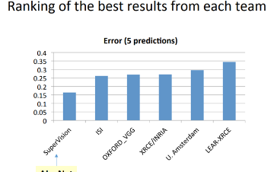

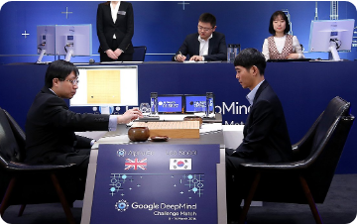

Breakthrough Examples
Computer Vision (2012): AlexNet wins ImageNet.
Reinforcement Learning (2016): AlphaGo defeats world Go champion.
Generative Models (2018+): Realistic image & text generation.

Slide 21
Part 7: Real-World Applications
Where Deep Learning is Used Today

Slide 22


Applications (Vision & Speech)
Computer Vision
Speech Recognition
Object detection (self-driving cars), facial recognition, medical image analysis (e.g., finding tumors).
Virtual assistants (Siri, Alexa), automatic transcription (ASR), and text-to-speech (TTS).

Slide 23


Applications (Text & Other)
Natural Language Processing (NLP)
Recommendation Systems
Machine translation (Google Translate), sentiment analysis, Q&A systems (like ChatGPT).
Powering "what to watch next" on Netflix or "products you may like" on Amazon.

Slide 24
Application Summary
Application | Input | Output | Neural Network Type
Real Estate (Price) | House features (sq ft, beds) | House Price ($) | Std NN (DNN)
Photo Tagging | Image | Text (Tags) | CNN
Object Detection | Image | Bounding box + Label | CNN (e.g., YOLO)
Speech Recognition | Audio | Text transcript | RNN / Transformer
Translation | English Text | French Text | RNN / Transformer

Slide 25
Part 8: Key Components of a DL Problem
The Four Pillars of Learning

Slide 26
The Four Components
[ASSIGNMENT-REQUIRED]
Core Components of a DL Problem
1. The Data that we can learn from.
2. A Model of how to transform the data.
3. An Objective (Loss) Function that quantifies how well the model is doing.
4. A Learning (Optimization) Algorithm to adjust the model's parameters to improve its performance.

Slide 27
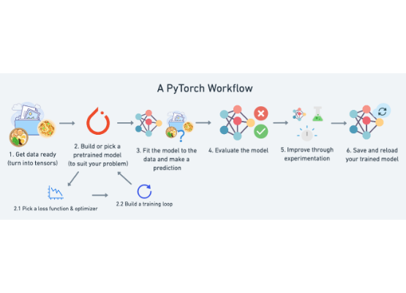
The Learning Loop
[ASSIGNMENT-REQUIRED]
The Optimization Loop
This is the core pipeline of training a model.
1. Model: Makes a prediction (Forward pass).
2. Loss: Calculates the error of the prediction.
3. Optimizer: Calculates parameter updates (Backward pass).
4. Update: The model's parameters are adjusted.
This loop is repeated many times.

Slide 28
Part 9: Component 1 - The Data
The Foundation of All Learning

Slide 29
Data Terminology
Examples, Features, and Labels
Example (or Sample): A single data point (e.g., one email, one image, one house).
Features (Covariates): The set of attributes used to make a prediction (e.g., square footage, number of bedrooms).
Label (or Target): The attribute to be predicted (e.g., "spam" or "not spam", the house price).

Slide 30
Data Example: House Prices
ID (Example) | Bedrooms (Feature) | Location (Feature) | Sq Ft (Feature) | Price (Target)
1 | 3 | Urban | 1500 | 350K
2 | 2 | Suburban | 1200 | 280K
3 | 4 | Urban | 2000 | 520K
4 | 3 | Rural | 1800 | 310K

Slide 31
Formal Data Representation
Dimensions: N and d
We often represent the dataset as D = {X, t}.
X is the matrix of features.
t (or y) is the vector of labels (targets).
N = Number of examples (rows in the table).
d = Number of features (columns), also called dimensionality.

Slide 32
Part 10: Component 2 - The Model
The Machinery for Transformation

Slide 33
What is a Model?
The "Computational Machinery"
A model denotes the computational machinery for ingesting data and making predictions.
Deep learning models consist of many successive transformations (layers) chained together.
Its goal is to learn a function f(X) that accurately predicts the target t.

Slide 34
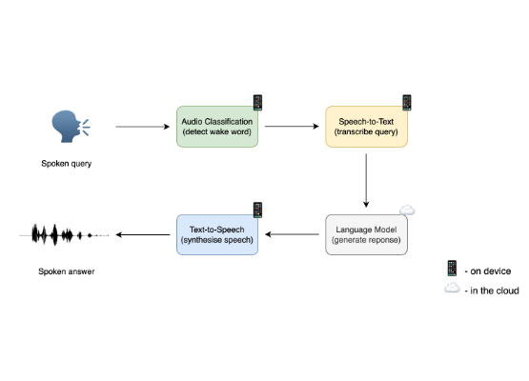
Example: Wake Word Model
A Simple Transformation
Input: An audio snippet (represented as numerical features).
Model: A trained neural network.
Output: A prediction from the set {yes, no}.
The model *transforms* the audio data into a simple binary choice.

Slide 35
Part 11: Component 3 - The Objective Function
Measuring Success and Failure

Slide 36
Purpose of the Objective Function
[ASSIGNMENT-REQUIRED]
What is an Objective Function?
A formal measure to denote how good (or bad) a mathematical model is.
"Learning" is the process of trying to make this function score "better".
It takes the model's predictions (y_hat) and the true labels (y) and calculates a single number.

Slide 37
Loss Function: Lower is Better
[ASSIGNMENT-REQUIRED]
Lower is Better
By convention, objective functions are defined so that lower is better.
Because lower is better, they are often called Loss Functions.
The goal of learning is to minimize the loss.
A high loss means the model is bad; a low loss means the model is good.

Slide 38
Part 12: Component 4 - The Learning Algorithm
How the Model Improves

Slide 39
What is a Learning Algorithm?
[ASSIGNMENT-REQUIRED]
The Search for Best Parameters
An algorithm capable of searching for the best possible parameters to minimize the loss function.
It's the mechanism that adjusts the model's parameters (weights) based on the data.
This is the "optimizer" part of the training loop.

Slide 40
The King: Gradient Descent
[ASSIGNMENT-REQUIRED]
Gradient Descent
The most popular algorithm for deep learning is gradient descent.
It uses calculus (specifically, the gradient) to find which way to "nudge" each parameter to reduce the loss.
It "descends" the "gradient" of the loss landscape towards a minimum.
This is the main learning algorithm you will use in your assignment.

Slide 41
Part 13: A Complete Framework
Example: The Wake-Word Problem

Slide 42
Steps to Build a DL Solution
Steps for Wake-Word Problem
1. Define the Problem: Map audio snippets to a {yes, no} label.
2. Collect Data: Gather a huge dataset of audio. Label each example as "yes" or "no". (This is Component 1).
3. Choose a Model Family: Decide on the model's structure (e.g., a specific neural network). (This is Component 2).
4. Train the Model: Use the data, a loss function (Comp 3), and gradient descent (Comp 4) to find the best parameters.

Slide 43
How to Create a Model?
Start with Parameters
We start with a program whose behavior is determined by a number of parameters (e.g., weights).
Initially, these parameters might be set randomly.
We then use data to adjust these parameters to improve the model's performance on our task.

Slide 44
Model Family
The Set of All Possibilities
The family of models is the set of all distinct programs (input-output mappings) that we can produce just by manipulating the parameters.
A single model *family* (e.g., a specific network architecture) can be used to solve similar tasks.
For example, the same model family could be trained to recognize "Alexa" or "Hey Siri".

Slide 45
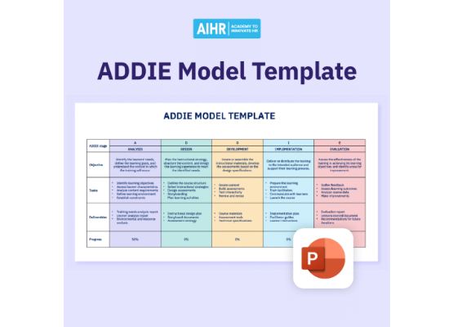
How to Train a Model?
The Training Process
"Training" is the process of fitting the parameters using data.
We use the learning algorithm to find the best set of parameters that minimizes the loss function.
This is the iterative "loop" we saw earlier.

Slide 46
The Final Model
The Final Product
Once the parameters are finalized (i.e., we stop training), we call the program a model.
This final model is what is deployed for prediction (also called inference).
This is the model that runs inside your phone or smart speaker.

Slide 47
Part 14: Kinds of DL Problems
Supervised, Unsupervised, and Reinforcement

Slide 48






Three Kinds of Learning
Supervised Learning
Unsupervised Learning
Reinforcement Learning
Learning from data that has labeled examples (features + correct answers). This is the focus of our course.
Learning from unlabeled data. The goal is to find hidden structures (e.g., clustering).
Learning by interacting with an environment. An "agent" learns to take actions to maximize a reward.

Slide 49
Part 15: Supervised Learning
Learning from Labeled Examples

Slide 50
The Supervised Workflow
The Supervised Pipeline
The most common type of machine learning.
The dataset consists of feature-label pairs.
The "supervision" comes from providing the model with the correct answers (labels).
The goal is to produce a model that predicts the label for new, unseen inputs.

Slide 51
Supervised Task 1: Regression
[ASSIGNMENT-REQUIRED]
Regression
The goal is to predict a continuous numerical value.
It answers the question "how much?" or "how many?".
Example: Predicting the price of a house (a number, e.g., $350,000).
Example: Predicting the temperature tomorrow (a number, e.g., 25.5°C).
Your assignment includes Linear Regression.

Slide 52
Supervised Task 2: Classification
[ASSIGNMENT-REQUIRED]
Classification
The goal is to predict a discrete class label (a category).
It answers the question "which category?" or "is this A or B?".
Example: Classifying an email as "spam" or "not spam".
Example: Classifying an image as a "cat", "dog", or "bird".
Your assignment includes Logistic Regression and Softmax Regression.

Slide 53


Types of Classification
[ASSIGNMENT-REQUIRED]
Binary Classification
Multi-class Classification
Predicts one of two possible classes. (e.g., Yes/No, Spam/Not-Spam). This is the task for Logistic Regression.
Predicts one of more than two, mutually exclusive classes. (e.g., Cat/Dog/Bird). This is the task for Softmax Regression.

Slide 54
Other Supervised Tasks
And Many More...
Recommendation Systems: Predicting what a user will rate a movie.
Sequence Learning:
Automatic Speech Recognition (ASR)
Text-to-Speech (TTS)
Machine Translation (MT)

Slide 55
Further Reading
Recommended Reading
Textbook (T1): "Dive into Deep Learning"
Chapter 1 provides a comprehensive overview of the introduction, history, and key components of deep learning.

Slide 56
Questions?

Slide 57


Module 1 Checklist
Assignment-Required Concepts
Textbook Reading
The 4 Core Components (Data, Model, Loss, Algorithm)
T1 (Dive into Deep Learning): Chapter 1
The Optimization Loop (Model → Loss → Update)
Objective (Loss) Function Purpose
Learning Algorithm (Gradient Descent)
Supervised Learning (Regression vs. Classification)
Binary (Logistic) vs. Multi-class (Softmax) Tasks

Slide 58
Appendix
Supplemental Code and Examples

Slide 59







Image Sources
https://miro.medium.com/1*SkcsypxHN5T_MIXmxJKSiA.png
Source: medium.com
https://media.geeksforgeeks.org/wp-content/uploads/20240610185102/Feature-Extraction-Techniques-in-Image-Processing.webp
Source: www.geeksforgeeks.org
https://towardsdatascience.com/wp-content/uploads/2017/10/11ADLHcqXhmtgDBkMF7b2Hw.png
Source: towardsdatascience.com
https://miro.medium.com/v2/resize:fit:1316/1*BASjitcB1kbfc0LH-Jtwjw.png
Source: medium.com
https://storage.googleapis.com/gweb-uniblog-publish-prod/images/AlphaGo_hero.width-1300.jpg
Source: blog.google
https://i.ytimg.com/vi/kSLJriaOumA/maxresdefault.jpg
Source: www.comet.com

Slide 60





Image Sources
https://raw.githubusercontent.com/mrdbourke/pytorch-deep-learning/main/images/01_a_pytorch_workflow.png
Source: www.learnpytorch.io
https://huggingface.co/datasets/huggingface-course/audio-course-images/resolve/main/voice_assistant.png
Source: huggingface.co
https://www.aihr.com/wp-content/uploads/ADDIE-Model-PPT-template-1024x1024.png
Source: www.aihr.com
https://www.mdpi.com/eng/eng-05-00021/article_deploy/html/images/eng-05-00021-g006.png
Source: www.mdpi.com

